Slide 1
COMPUTATIONAL SOCIAL SCIENCES
The New Program for Computational Social Sciences @BSC
Mercè Crosas, Ph.D.
Head of Computational Social Sciences Program (bsc.es)
President of CODATA (codata.org)

Slide 2
1.Computational Social Sciences?
2. The New Program on Computational Social Sciences

Slide 3
Computational Social Sciences?

Slide 4
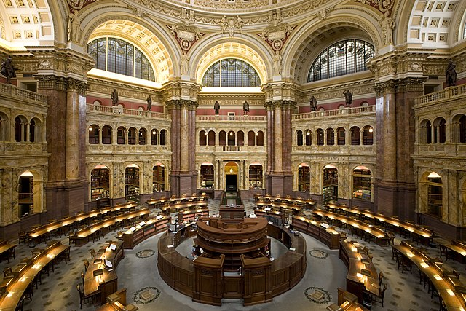
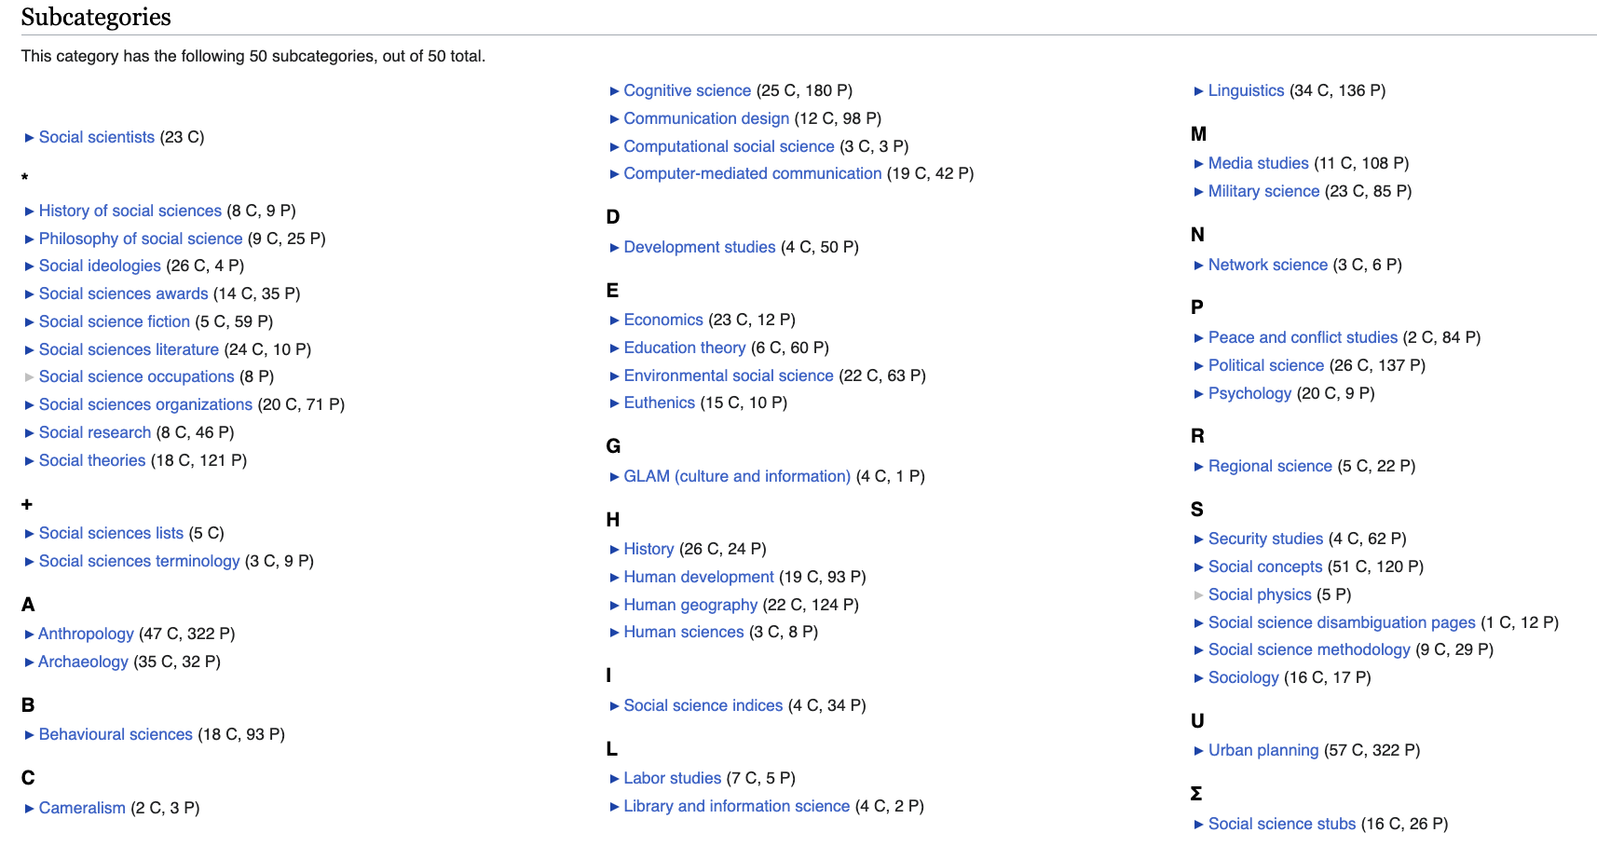
U.S. Library of Congress Classification:
Social Sciences
50 subcategories
Including anthropology, economics, geography, history, political science, psychology, social studies, sociology.
https://en.wikipedia.org/wiki/Category:Social_sciences

Slide 5
Wikipedia
Social Sciences:
Anthropology
Area studies
Communication studies
Criminology
Development studies
Economics
Education
Environmental studies
Gender studies
Geography
History
Industrial relations
International relations
Law
Library science
Linguistics
Media studies
Political science
Psychology
Sociology
Sustainable development

Slide 6
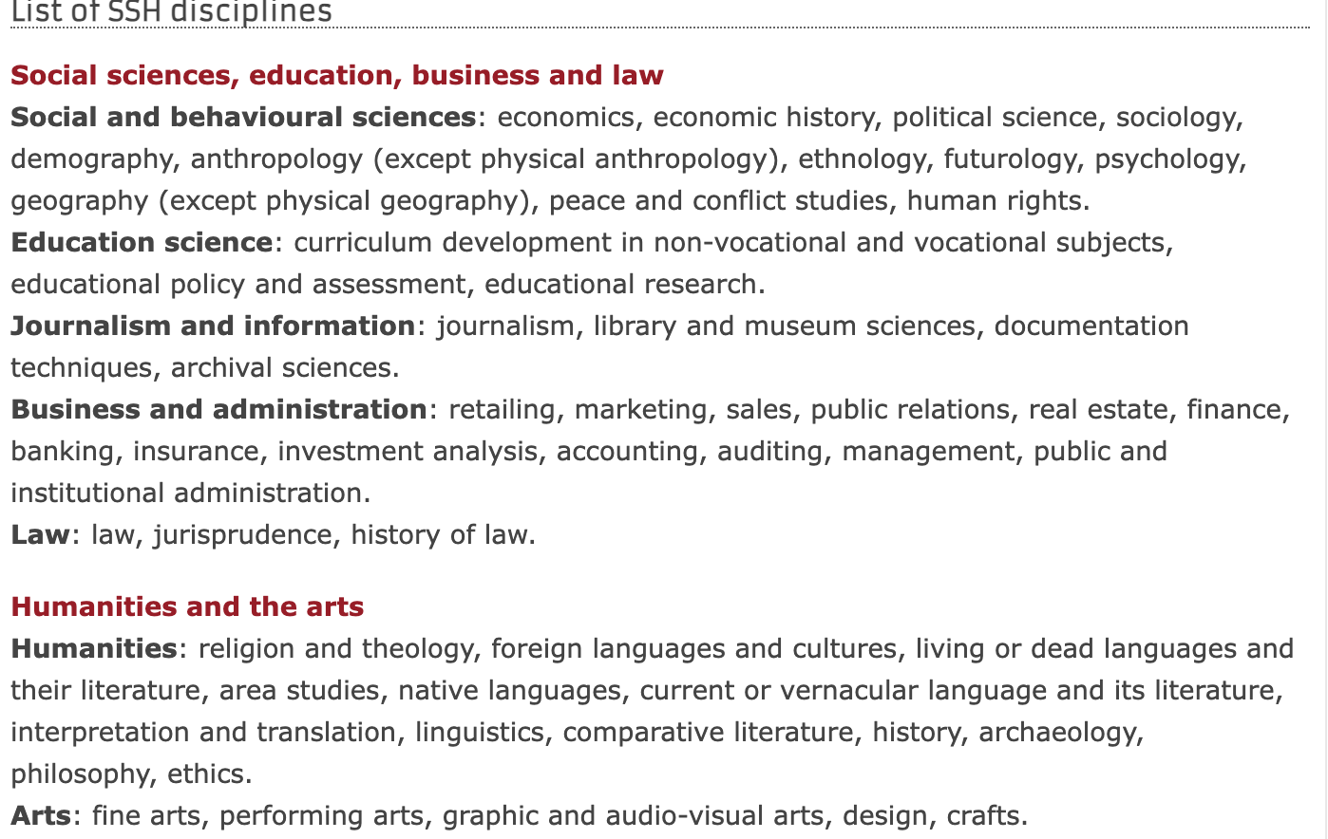

European Commission:
Social Sciences and Humanities (SSH) category
Based on the UNESCO International Standard Classification of Education
https://ec.europa.eu/research/participants/docs/h2020-funding-guide/cross-cutting-issues/ssh_en.htm

Slide 7
The new program at BSC uses the EC category:
Social Sciences and Humanities

Slide 8
Computational Social Sciences?

Slide 9
From Quantitative Social Science …
Census Data and National Statistics
1622,
Registration of local citizenship,
Wurttemberg, Germany
1665,
First modern census, Quebec, Canada
1719,
First systematic records in Europe (Prussia)
1800s,
England, France, Norway,
1828, Australia
1853,
Chile passes the first Census Law in South America
Today, most countries have census data (except for a very few exceptions)
3800 BC, first census, Babylon
1790,
First Census in the USA
Data archives, repositories & statistical models
Surveys, interviews, experimental data
1924,
Odum Institute, first social science research center
1947,
Roper Center first social science data archive
1960s,
ICPSR social science data archive
UK Data Archive
1970s,
IASSIST
CESSDA (UKDA, ZA, DDA, NSD, BASS, ADPSS, Steinmetz)
1990s,
Australian social science data archive
1991,
IPUMS,
Largest microdata database
2006,
IQSS, Harvard Dataverse: Sharing social science research data
Big Data & AI
e.g., social media, news, web scraping satellite, sensors, administrative data, business data

Slide 10
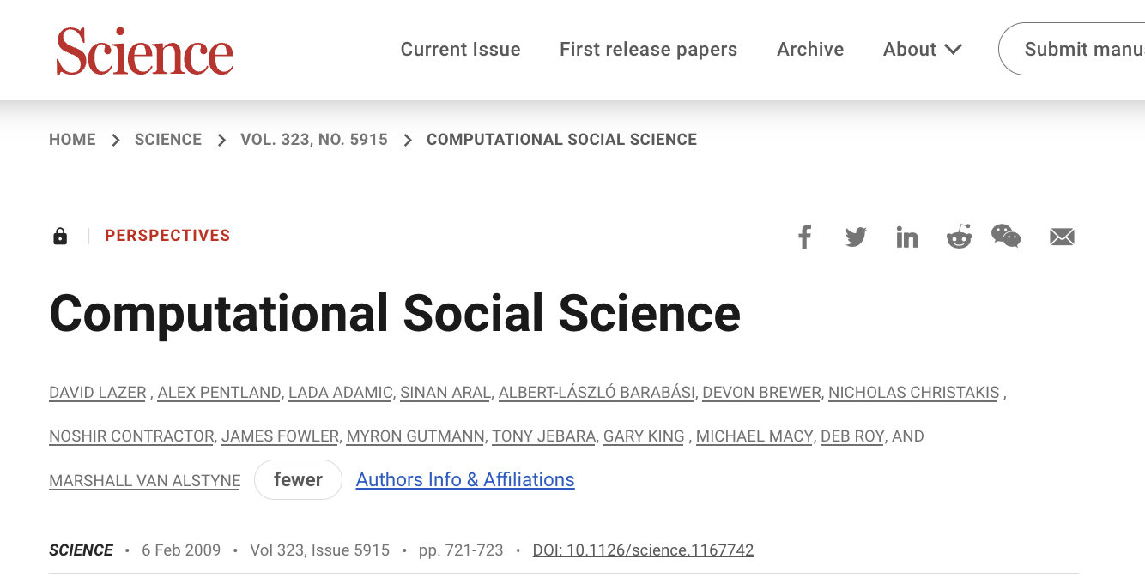
… to Computational Social Science
2009
“The capacity to collect and analyze massive amounts of data has unambiguously transformed such fields as biology and physics.
…
To date the vast majority of existing research on human interactions has relied on one-shot self-reported data on relationships. New Technologies (surveillance, email, internet, GPS tracking,….) offer a remarkable second-by-second picture of interactions over extended periods of time, providing information about both the structure and content of relationships”

Slide 11
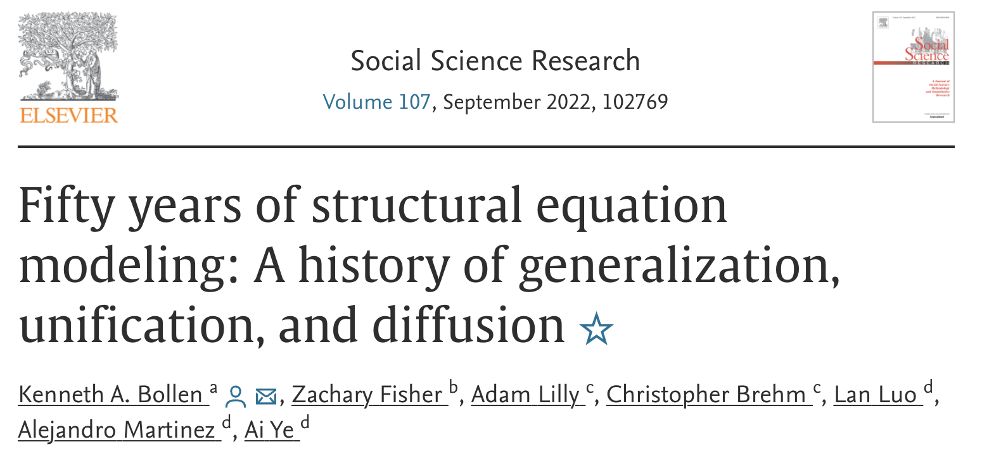
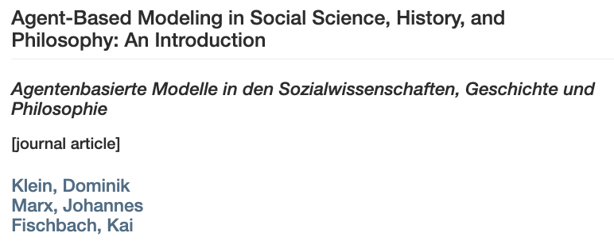
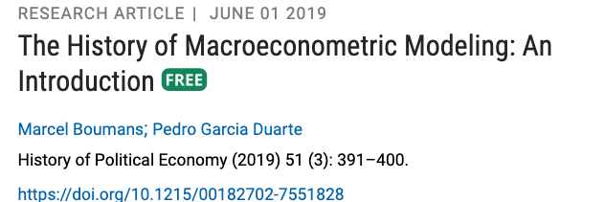
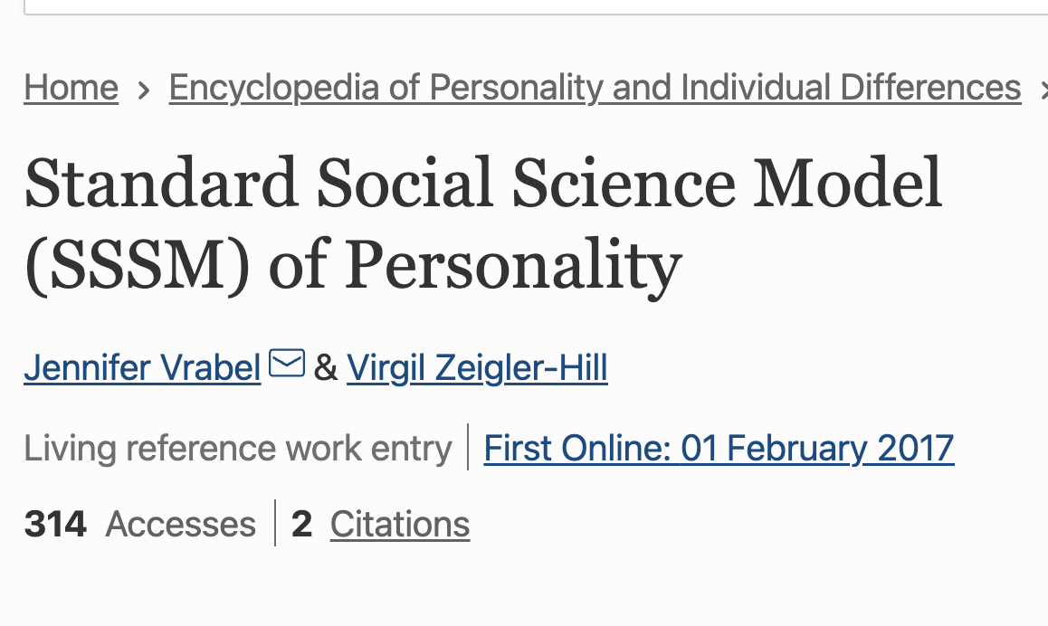
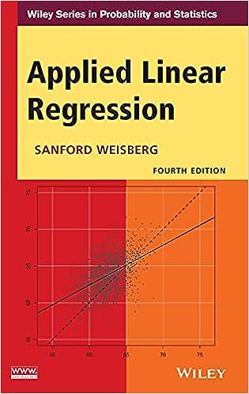


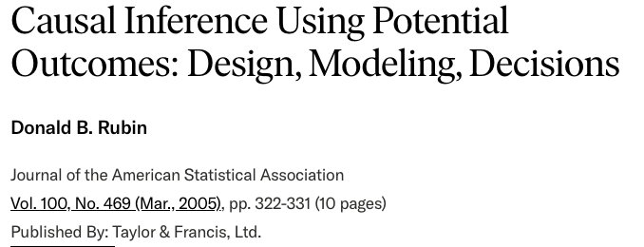
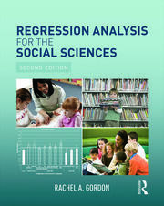
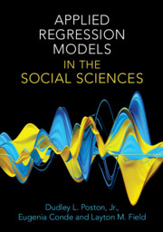
A century of Modeling in social science:
Most widely used is linear regression

Slide 12
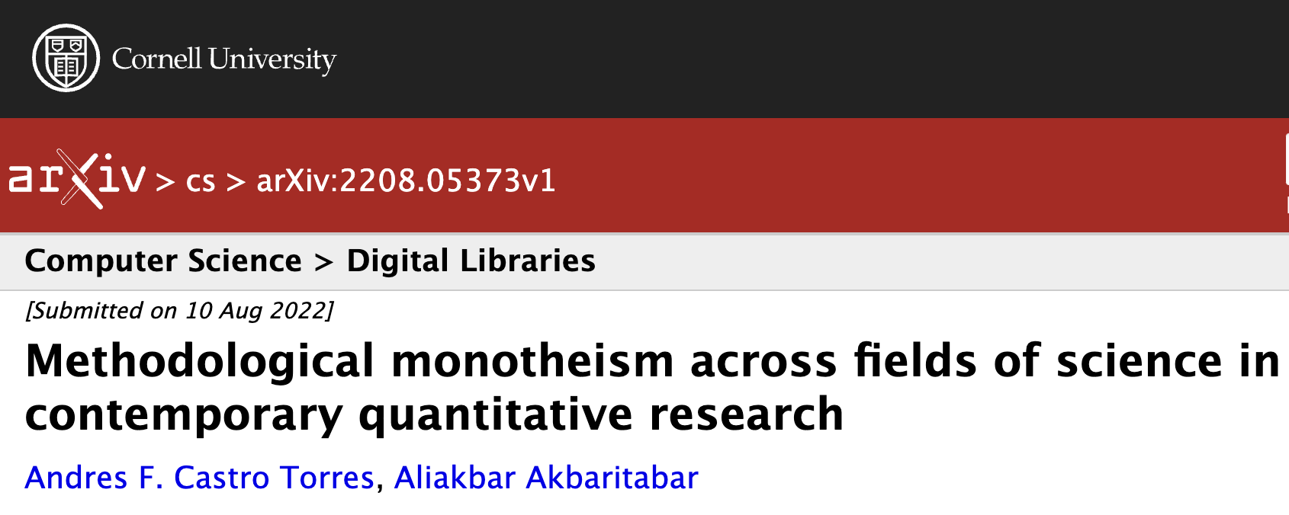
Methodology Analysis in Science:
Linear Models are hegemonic among Social Sciences
Using bibliometric data from the Web of Science, conduct a large-scale and cross-disciplinary assessment of the prevalence of linear-model-based research from 1990 to 2022.
Corpus 1: 7,164,784 articles - articles reporting methods or quantitative data in abstract
Corpus 2: 13,720,556 articles – any kind of empirical evidence
Results:
  High prevalence of linear-model-based research in the social sciences (60%)

Slide 13
Recent Methods in Computational Social Science
Text (and image/video) Analysis
  Artificial Intelligence (AI)/Machine Learning(ML), Natural Language Processing (NLP), Large Language Models (LLM)/Transformers
  Clustering, Topic Modeling, Positioning
(Complex) Regression Analysis:
  Multilevel models (nested data)
  Multivariate models
Complexity Science:
  Social Network Analysis (SNA)
  Agent-Based Modeling (ABM)
  (Scaling theory)

Slide 14
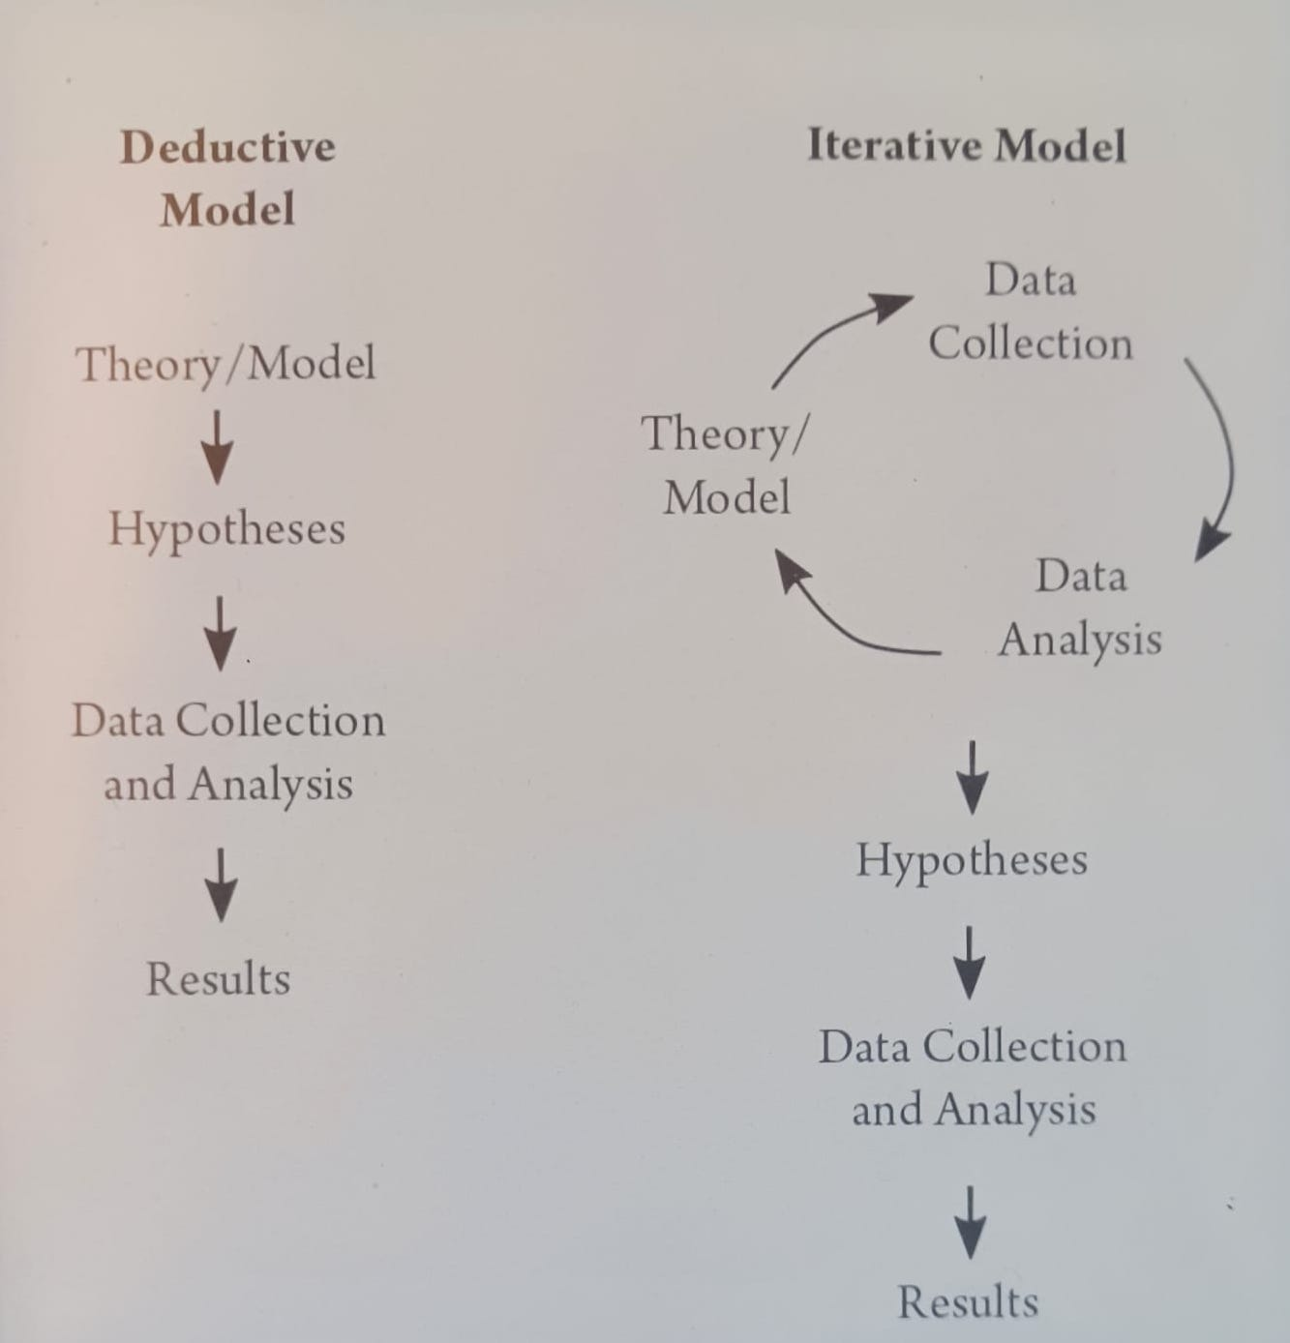
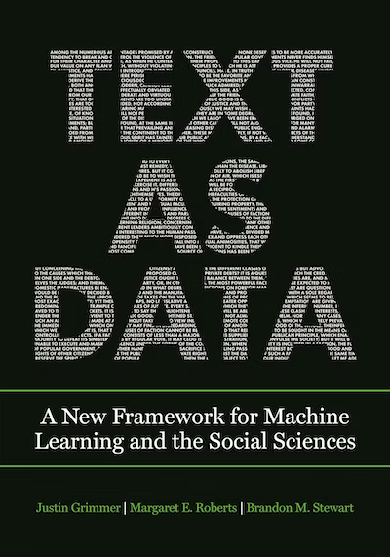
Text as Data in Social Sciences
  Text converted to Data:
  Representation of text in documents as vectors
  n-grams as tokens
  N dimensional space, distance among documents
  Used in Social Science for:
  Discovery
  Measurement
  Inference (causal and predictive)
Figure 2. from Text as Data, Grimmer, Roberts, Stewart

Slide 15
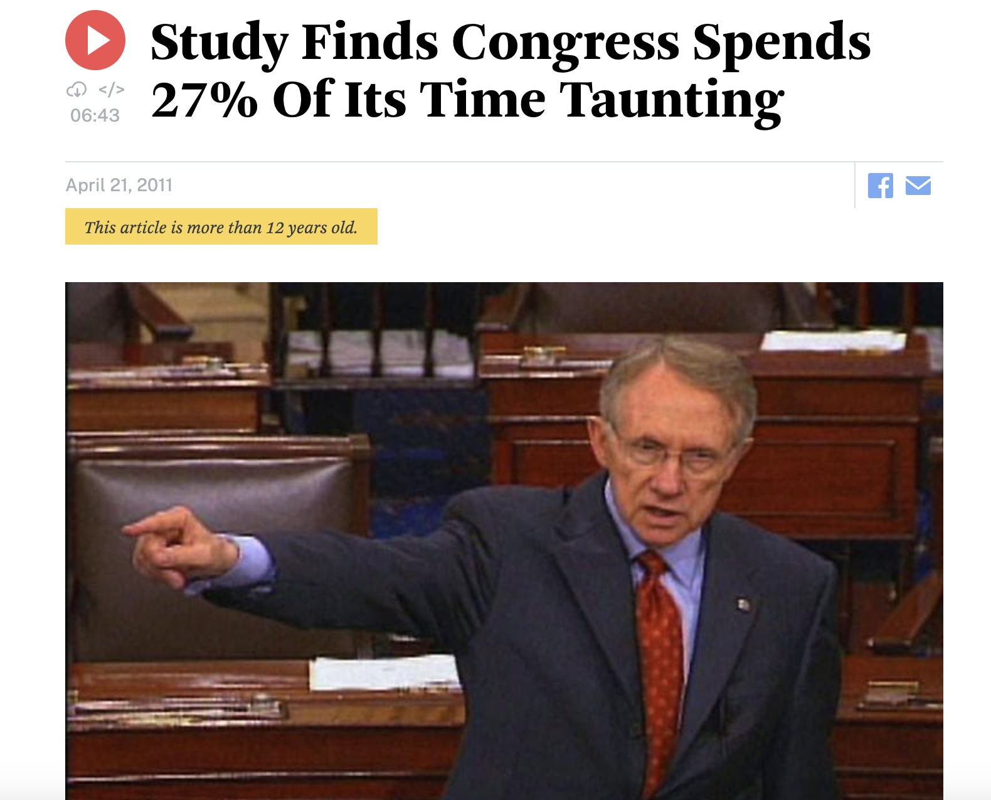
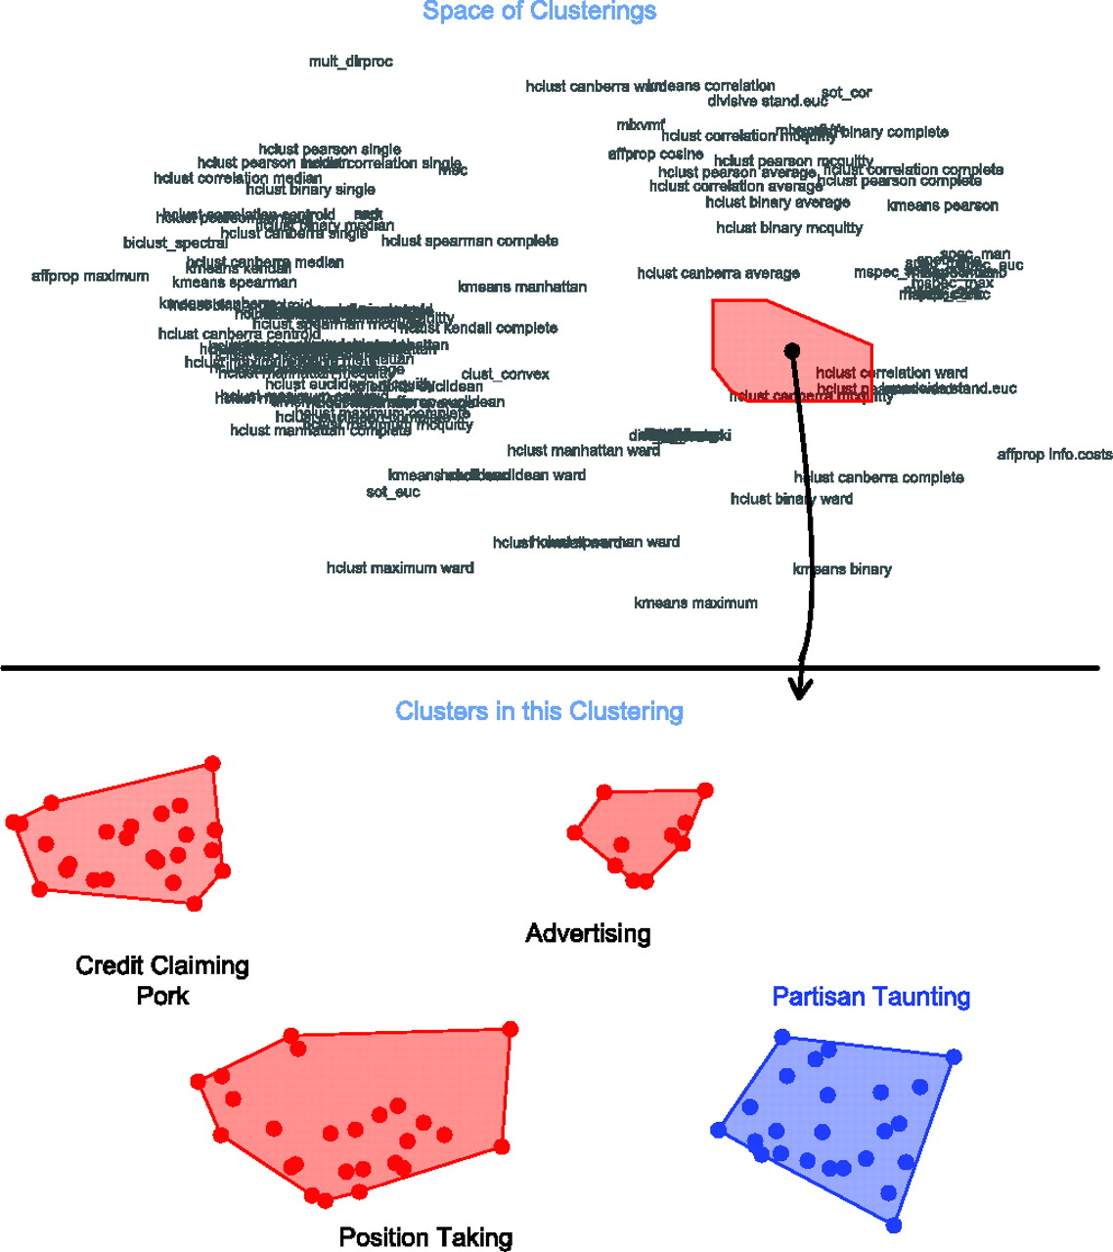
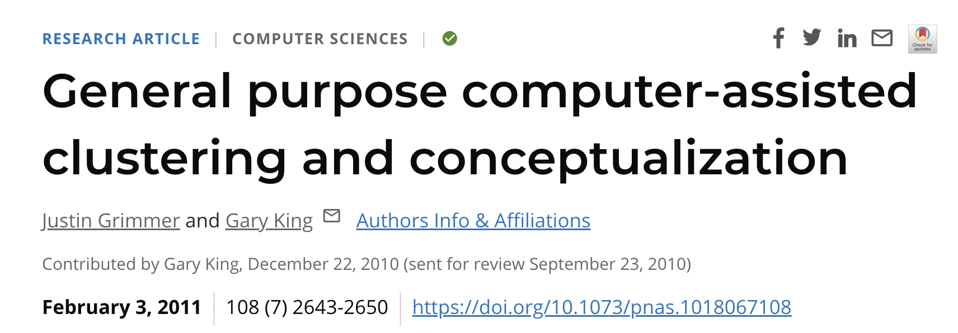
https://www.pnas.org/doi/10.1073/pnas.1018067108

Slide 16
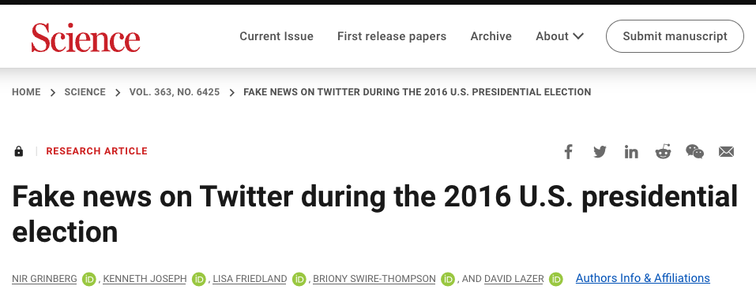
“Fake news accounted for nearly 6% of all news consumption, but it was heavily concentrated—only 1% of users were exposed to 80% of fake news, and 0.1% of users were responsible for sharing 80% of fake news.”
Used Twitter data linked to public voter registration records, studying the tweets sent by more than 16,000 accounts from August to December 2016.
Logistic regressions, clustering algorithms, social network analysis

Slide 17
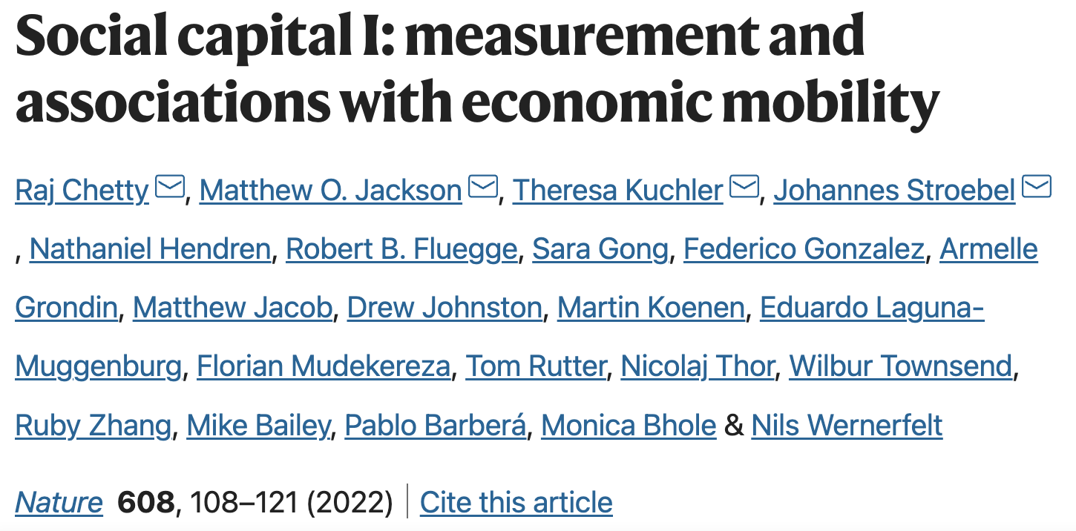
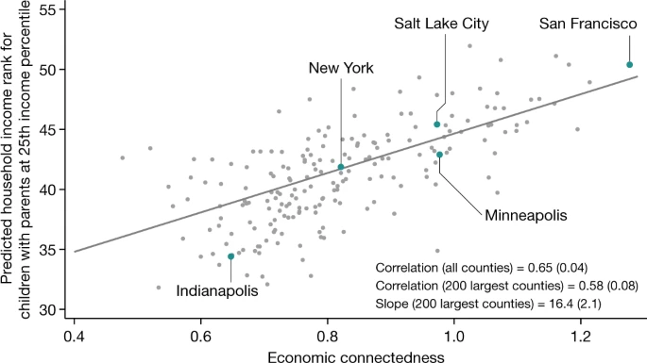
21 billion relationships from Facebook
Measure Social Capital:
  (1) cross-type connectedness,
  (2) network cohesiveness
  (3) civic engagement
Multivariate regressions
Economic connectedness (high economic status friends for individual with low economic status) is the higher predictor of upward income mobility
https://www.nature.com/articles/s41586-022-04996-4
https://www.nature.com/articles/s41586-022-04997-3

Slide 18
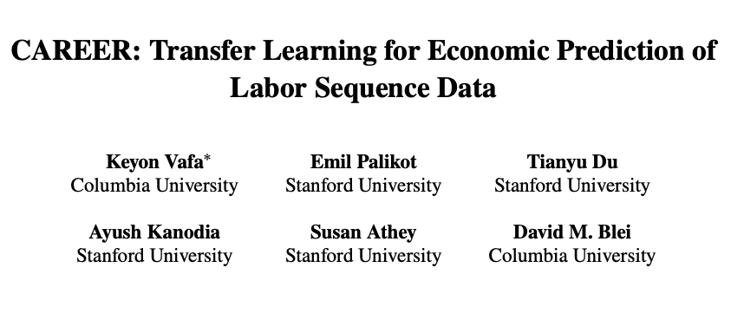
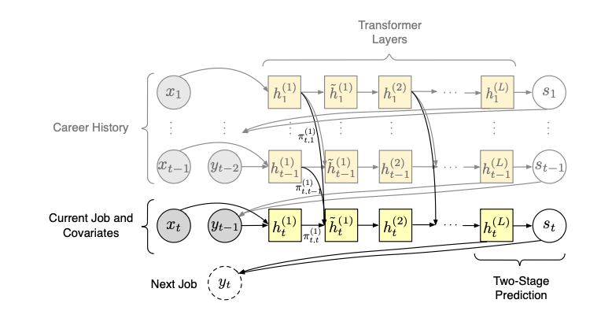
Using resumes for economic analysis of labor market
24 Million resumes (Zippia)
Create a transformer-based model that uses transfer learning to learn representations of job sequences: CAREER
Fine tune model with traditional longitudinal survey data predictive models
CAREER parameterizes a low-dimensional representation of an individual’s career history with a transformer, which it uses to predict the next job.
https://arxiv.org/abs/2202.08370

Slide 19
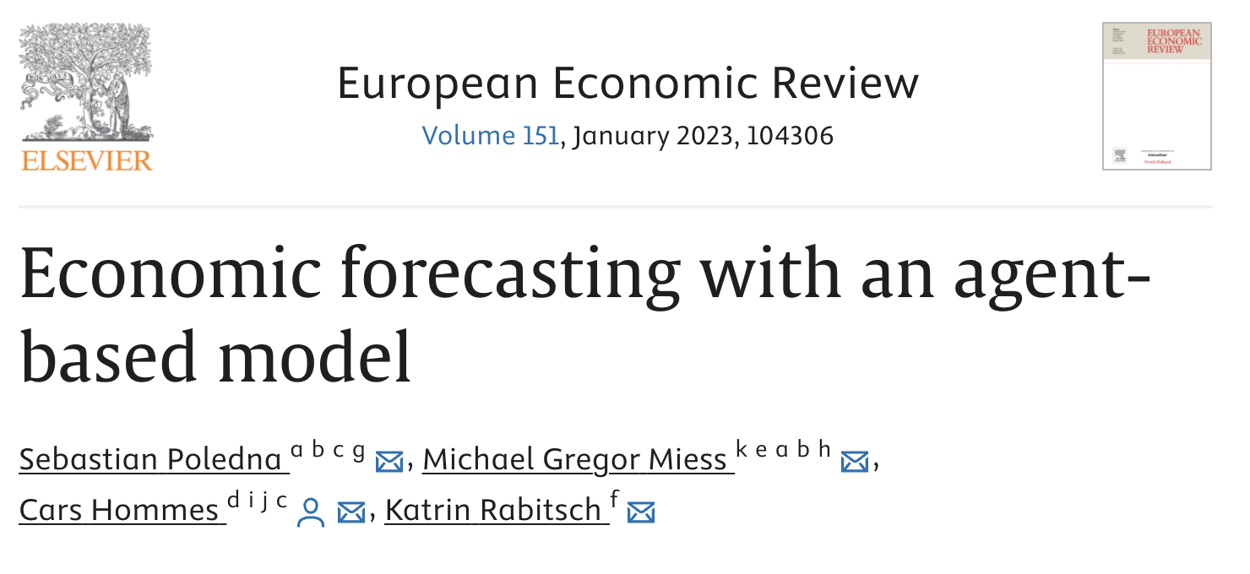

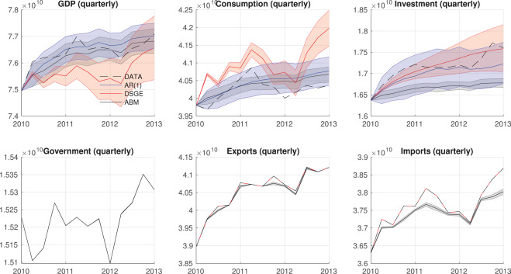
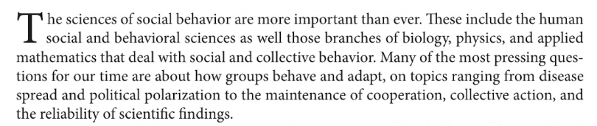
Agent-Based Modeling in Economics & Social Behavior

Slide 20
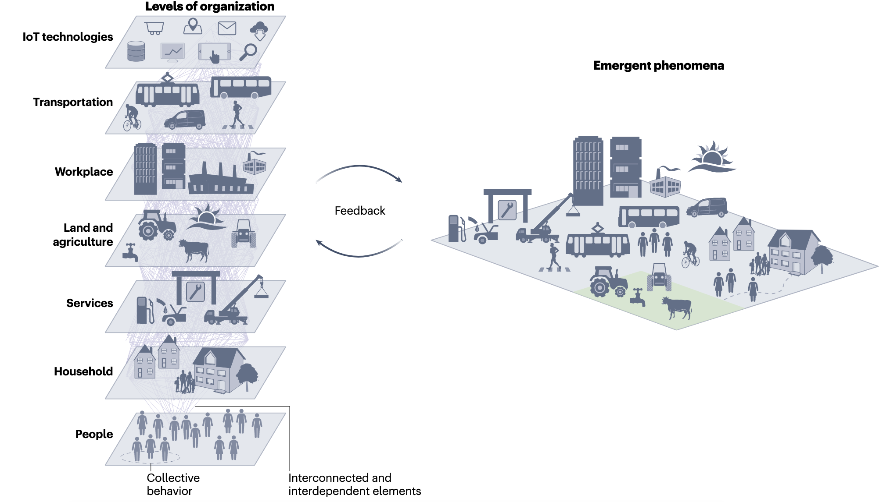
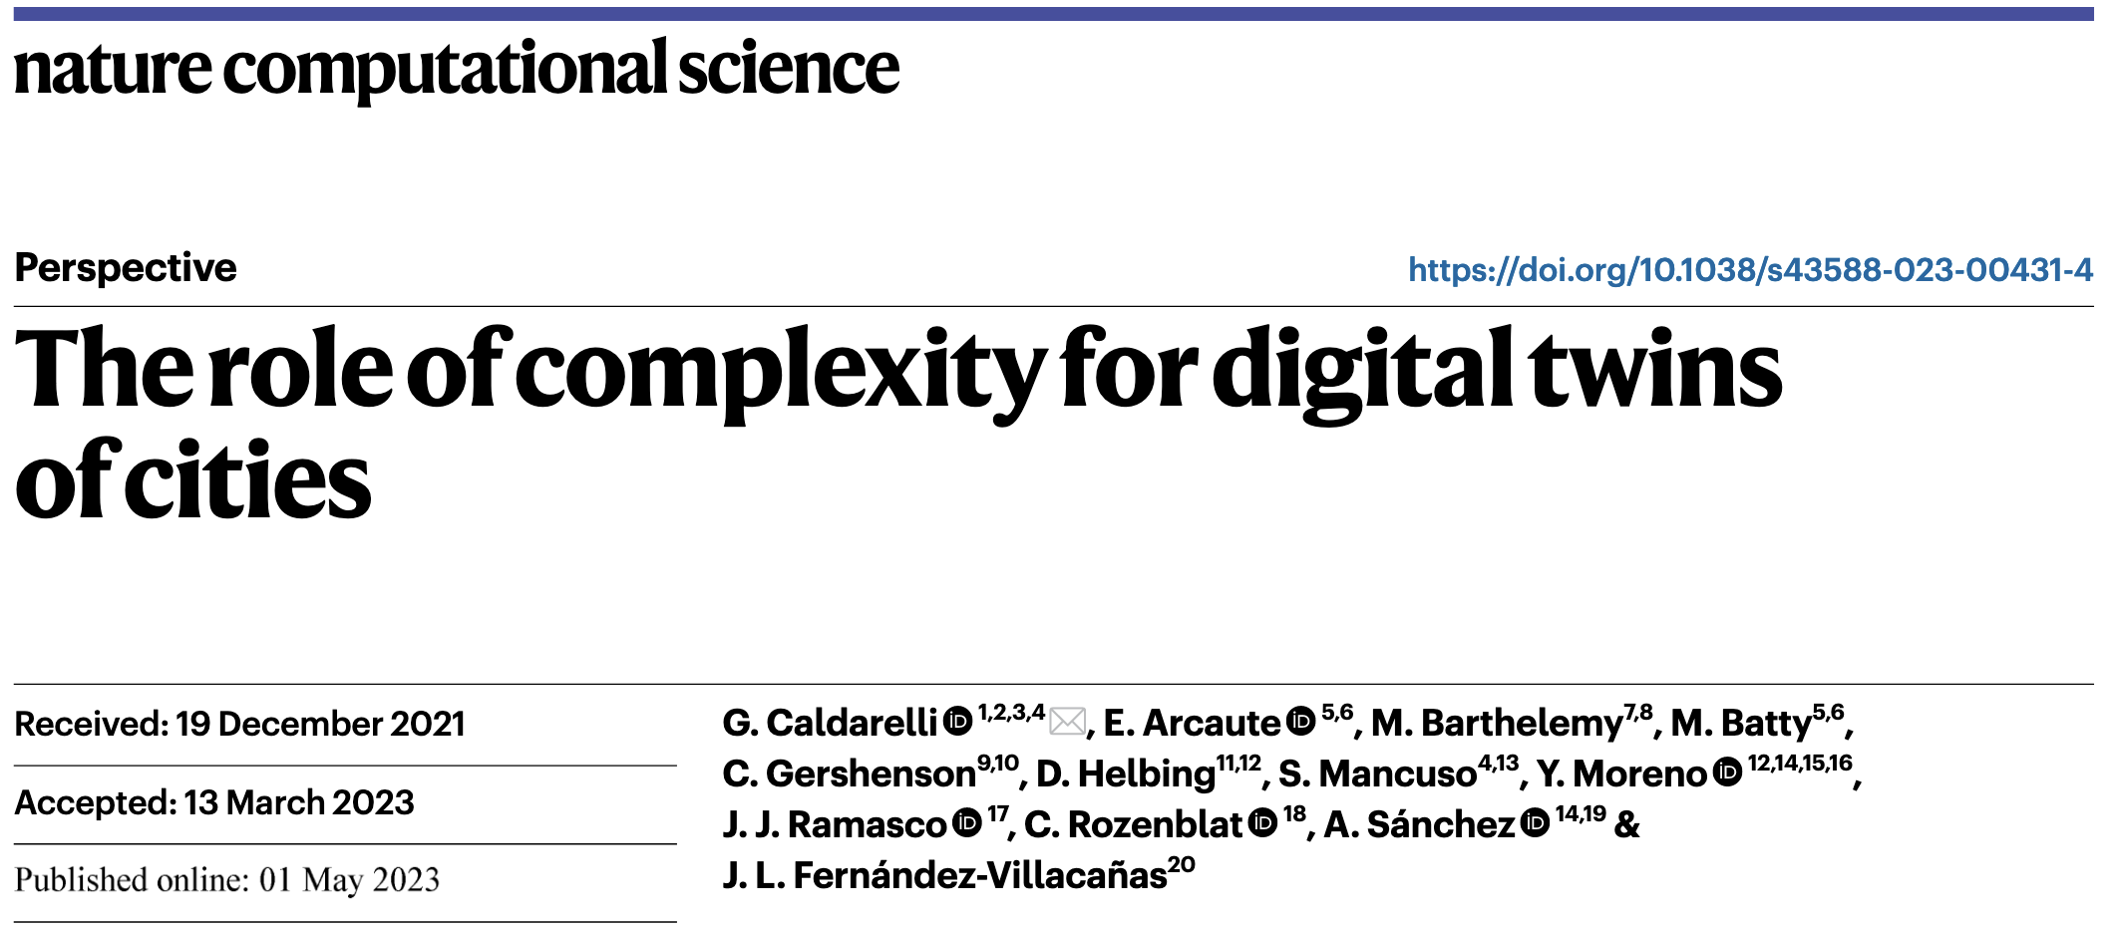
Modeling Cities and Social Behavior as Complex Systems

Slide 21
Independent of the quantitative methods, computational Sciences ought to be scientific

Slide 22
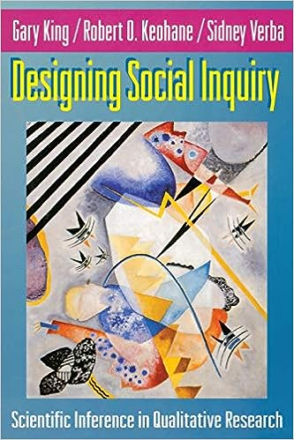
“The Science in Social Science”
“ … social scientific research can be quantitative or qualitative in style. “ But ought to be scientific in approach:
The goal is inference: Scientific research is designed to make descriptive or explanatory inferences on the basis of empirical information about the world.
The procedures are public: Scientific research uses explicit, codified, and public methods to generate and analyze data whose reliability can therefore be assessed.
The conclusions are uncertain: … Inference without uncertainty estimates is not science as we define it.
The content is the method: (Karl Pearson, 1892) `The unity of all science consists alone in its method, not in its material´”

Slide 23
The Why in Social Science: Causal Inference
The motivation for much research in social science are simple cause-and-effect questions:
Does X cause Y?
If X causes Y, how large is the effect of X on Y?
Is the size of this effect large relative to the effects of other causes of Y?
Counterfactuals and Causal Inference
Morgan and Winship, 2015

Slide 24
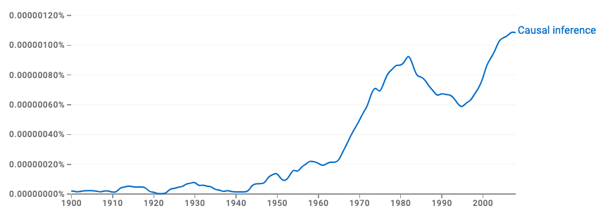
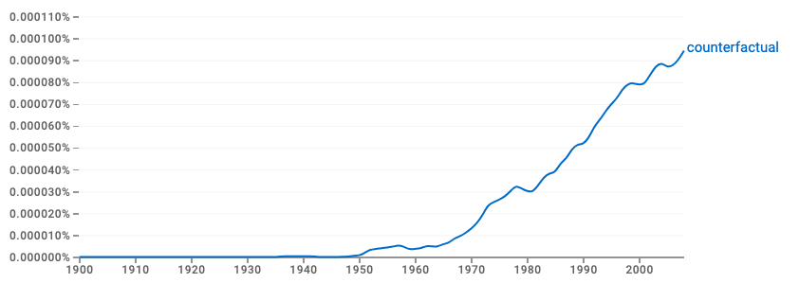
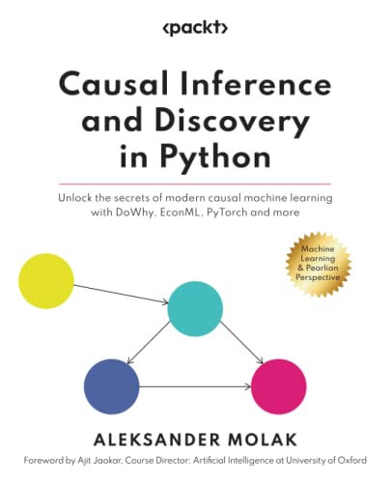
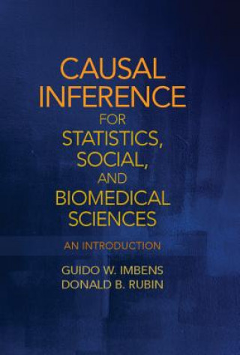


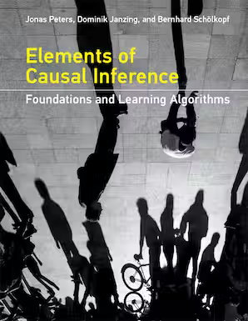

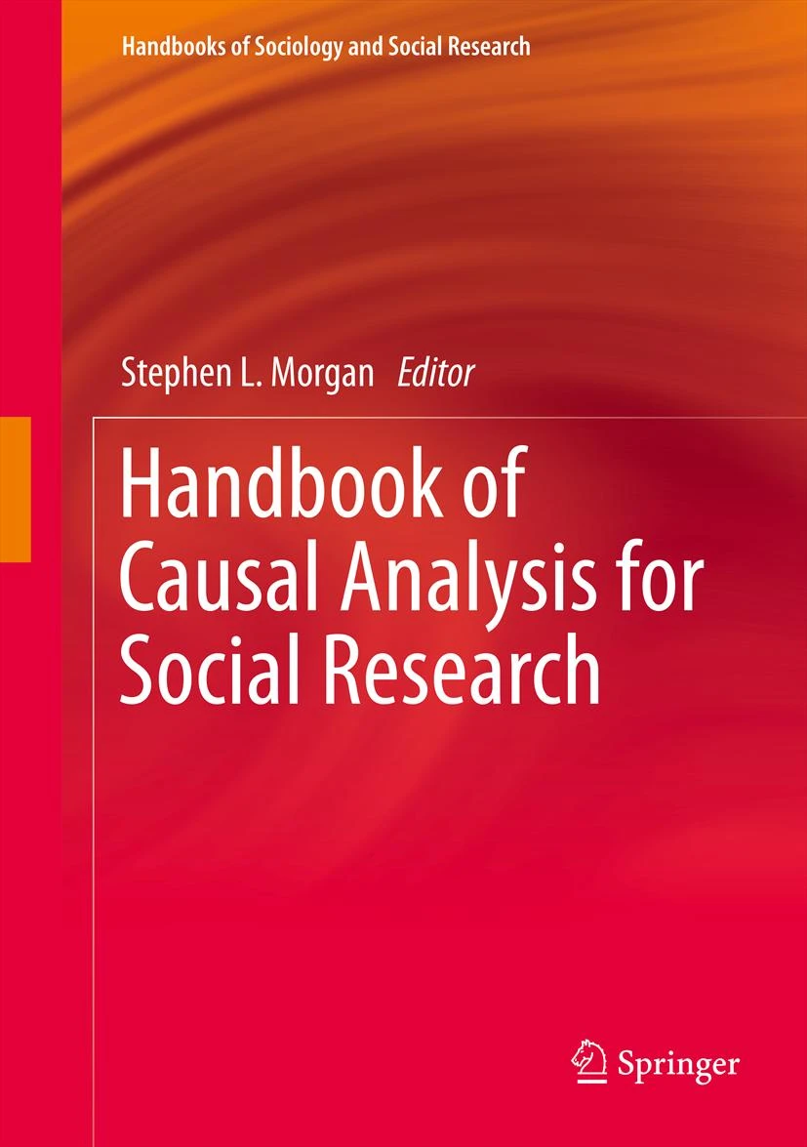
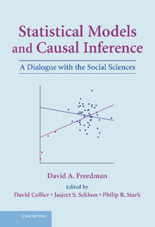
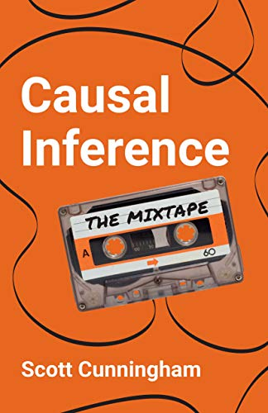
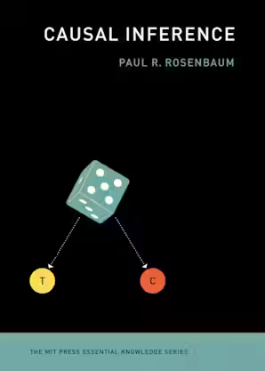

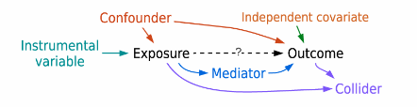
Evolution of Causal Inference in Social Science
Causal Inference
Counterfactual
1920s, Wright: Path diagrams and structural equations modeling (SEM)
1960s, Blalock, Duncan: Regression equations and path diagrams
1923, Neyman: Potential outcomes in randomized experiments
1935, Fisher: Randomization as the “reasoned basis” for inference: Randomized Controlled Trials (RCT)
1974, Rubin:
Potential outcomes model for observational data
2000s, Pearl
Causal diagrams

Slide 25

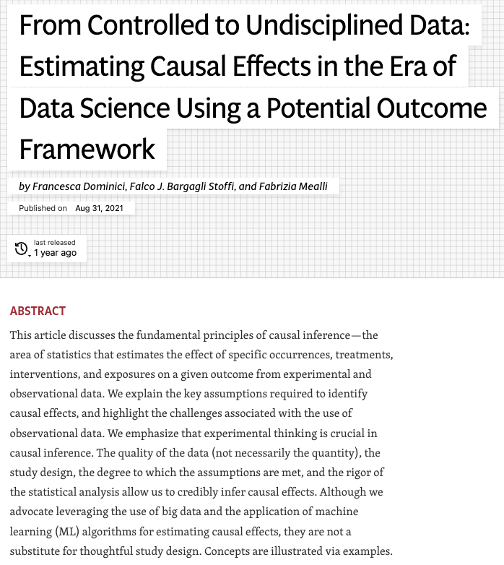
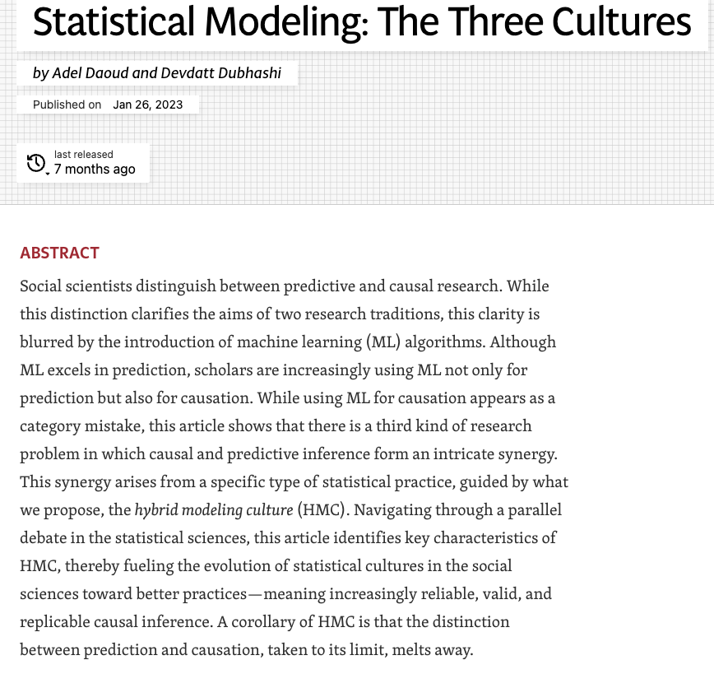
ML/AI and Causal Inference?
ML and Data Science is about observational data.
ML alone can´t resolve causal inference
Confounding bias is a key challenge when estimating causal effects from observational data
Lack of RCT, no guarantees that covariates are balanced between groups.
For objective causal inferences from observational data, need careful design following RCT approach.
Hybrid Statistical-Modeling Culture:
A hybrid between Data Modeling culture vs. Algorithm Modeling culture
Aligned to the overarching aim of science
Combines causal inference and prediction
Uses ML to impute potential outcomes

Slide 26
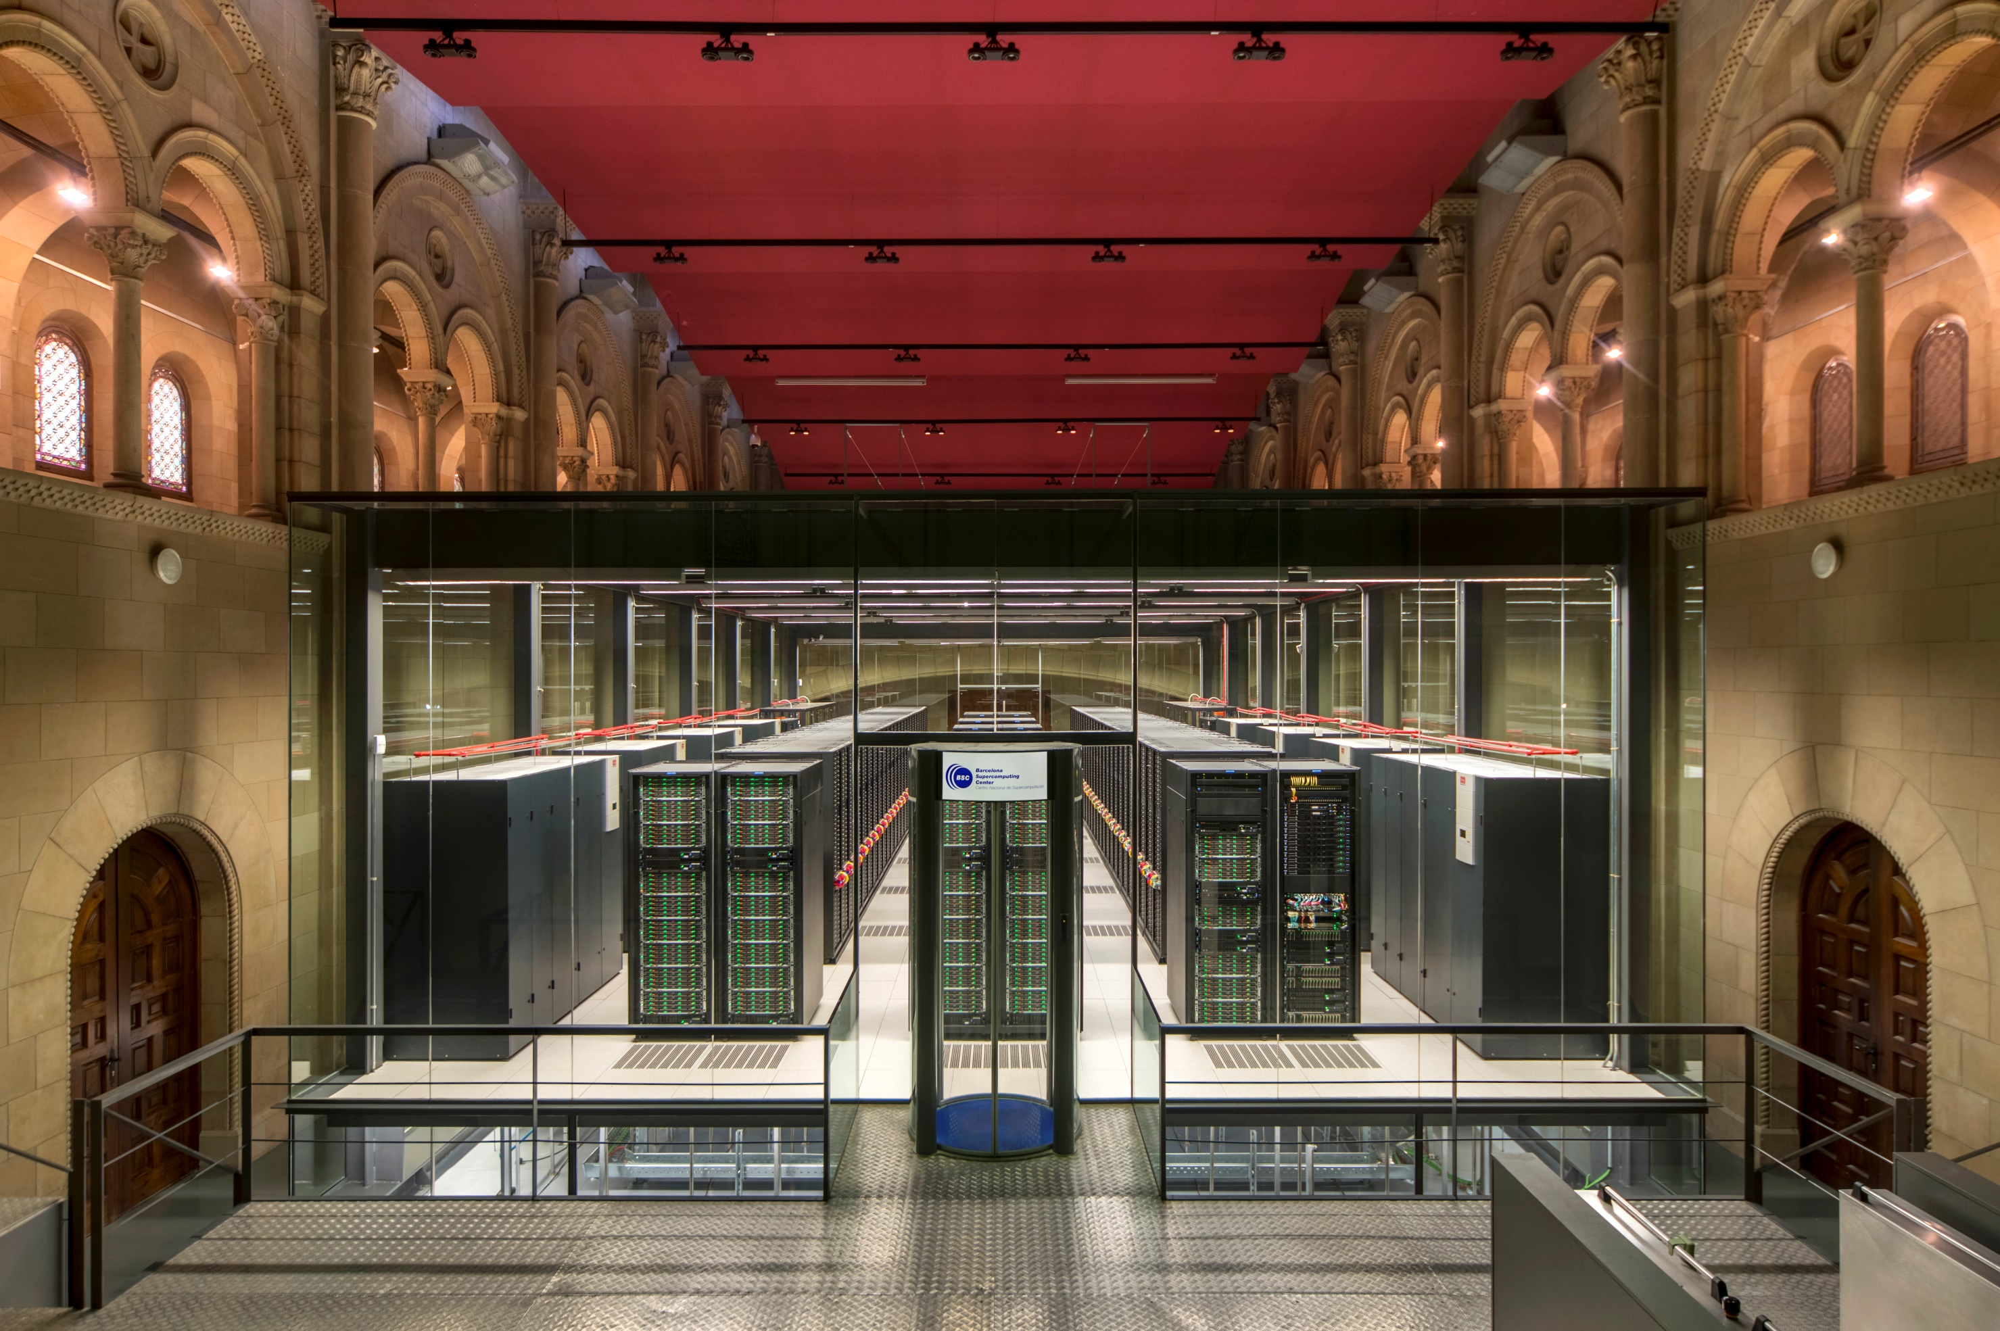


The New Computational Social Science Program at the Barcelona Supercomputing Center

Slide 27
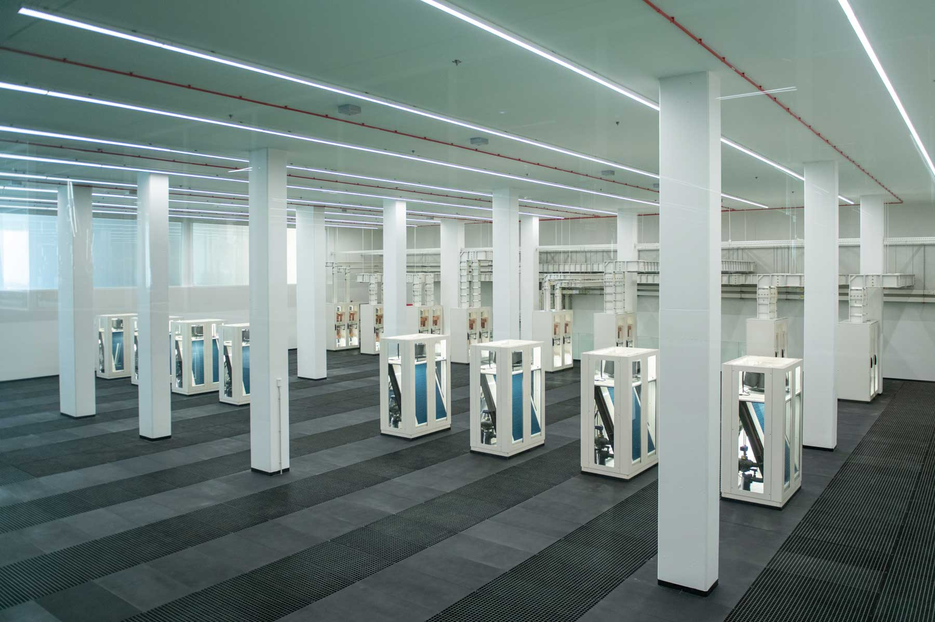
A Supercomputer for research:
Supercomputing services to Spanish and EU researchers:
  RES
  EuroHPC JU
Launched in 2005, with Mare Nostrum 1
Now, 900+ people
MARE NOSTRUM 5
Pre-exascale Supercomputer
314 Petaflops peak performance
200 Petabytes storage
400 Petabytes active archive

Slide 28



Access to MareNostrum 5
EuroHPC JU access programmes
  Extreme Scale Access, 2 calls per year
  Regular Access, 3 calls per year
  Benchmark and Development Access, rolling call
Spanish HPC programme
  3 calls per year, for HPC and IA access
Collaborations with BSC research
  Always open

Slide 29
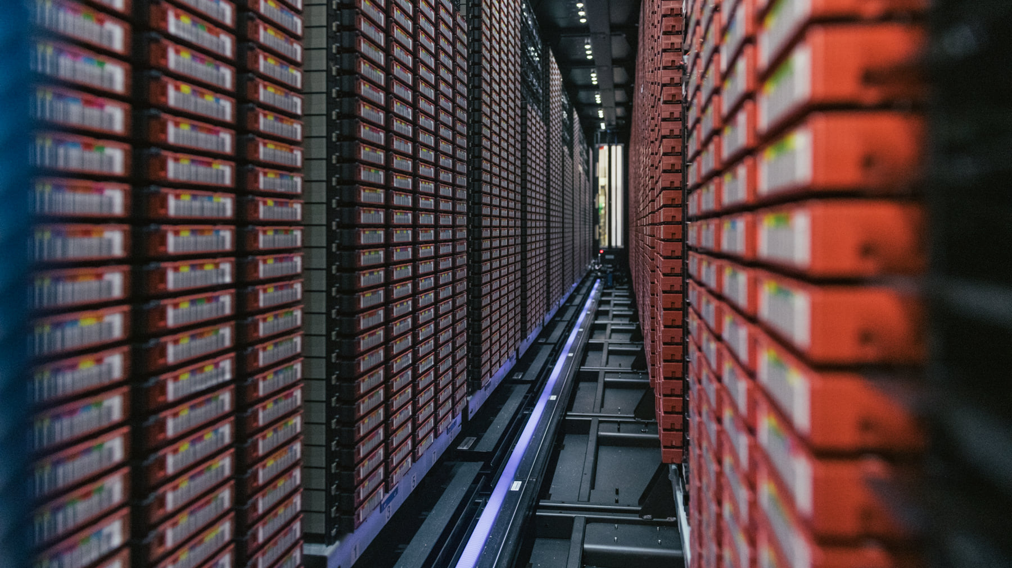

Access to Data exploitation services
Agora
  150PB on HSM (disk/tape)
MareNostrum 5 storage system
  240PB on disk
  400PB on tape
Access through Spanish Supercomputing Network
  Year call for 3-5 year projects
  From 200TB to 1PB per project
  Year review of DMP

Slide 30
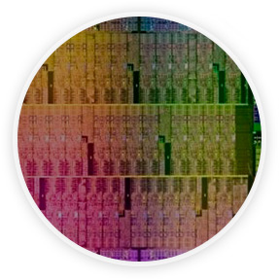



BSC is also a Research Organization
Computer
Sciences
Earth Sciences
Until now, 4 scientific departments, which use data and computation to advance their research.
In 2023, BSC has created a new cross-departmental scientific Program for Computational Social Sciences.
To influence the way machines are built, programmed and used: programming models, performance tools, Big Data, Artificial Intelligence , computer architecture, energy efficiency
To develop and implement global and regional state-of-the-art models for short-term air quality forecast and long-term climate applications
Life
Sciences
CASE
To understand living organisms by means of theoretical and computational methods (molecular modeling, genomics, proteomics)
To develop scientific and engineering software to efficiently exploit super-computing capabilities (biomedical, geophysics, atmospheric, energy, social and economic simulations)

Slide 31
Program´s Vision
Prepare the social sciences and humanities to benefit from the age of data and AI
Increase collaboration between social scientists and computer scientists
Facilitate the use of High-Performance Computing (HPC) to social science researchers, making HPC more approachable to all scientists
Apply social science research to assist policy making

Slide 32
Program´s Strategy
Computational Social Sciences Program
Research projects
Tools and Services
Education and Training
Community and Outreach
Four areas of work that together help create and support new research in computational social sciences and digital humanities:
  Collaborate in Research Projects
  Provide support of Tools and Services
  Foster Community and Outreach
  Create new materials for Education and Training

Slide 33
Program´s Research Projects and Methods
Research topics:
Demography
Democracy Quality
Socioeconomic impact of climate change
Social Innovation
History and cultural heritage
…
Methods: statistical models, AI/machine learning (text & image analysis), LLMs for social sciences, agent-based simulations, …
Data: surveys, national statistics, social media, historical archives, laws, regulations and national plans, interviews, citizens volunteered data, industry data

Slide 34




Initial Research Projects (i)
Two preliminary scientific research projects starting this fall:
Unravelling Household Composition and Change through the implementation of the first World-Scale Multilevel Analysis
  Collaboration between Centre d´Estudis Demogràfics (Albert Esteve) and BSC (Mercè Crosas)
  Multilevel regression models with data from 791 country-year samples of 155 countries
  Start with descriptive inference
  Funded by Fundació Caixa
LLM for Social Sciences
  Collaboration between Harvard University (Gary King, Stefano Iacus) and BSC (Mercè Crosas)
  With open-source code and open data
  Trained specifically for social science research
  Develop scientific and responsible practices for its use

Slide 35
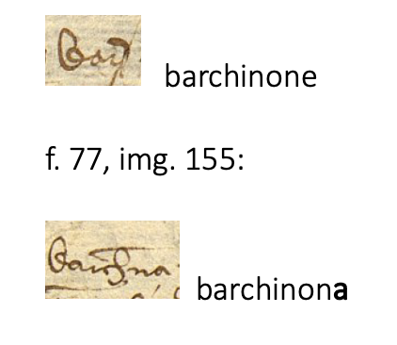
Initial Research Projects (ii)
Transcription and Indexing of historical text with AI
  Arxius Històrics de Protocols de Barcelona
  Arxius de la Marquesa de Barberà
  Image recognition and analysis
  Collaboration with UB
Text Analysis applied to energy policy and social impact of environment and climate change
  Natural Language Processing (NLP) to analyze national energy plans - with Earth Sciences
  BIG-5 (environment and social media): ERC project with Johannes Langemeyer (UAB)
  CLIMIATICAT – AGAUR project with Life Sciences (with Marta Reynol, UPF)
Impact of the information environment to Democratic Quality
  European Consortium, with UB, UOC
  Simulations (ABM) on how we intake and share news/information
  Assist public policy interventions, w/ virtual experiments

Slide 36
A big part of computational social science is about the data

Slide 37
Tools and Services, for Reproducibility and FAIR, Responsible use of Data
  Build a FAIR data repository for Social Sciences (in Spain)
    Federate existing social science data repositories
    Implementation based on an open-source data sharing platform (Dataverse.org)
  Integrate datasets in the repository with supercomputing
    Implement computational workflows to prepare dataset analysis for High-Performance Computing
  Explore AI to assist with generation of common metadata
    Create metadata mappings and connect datasets across disciplines/domains in the data space
  Test systems for sharing and analyzing sensitive data for social science research
    Set up data enclaves with levels of access and explore the use of differential privacy (OpenDP.org)

Slide 38
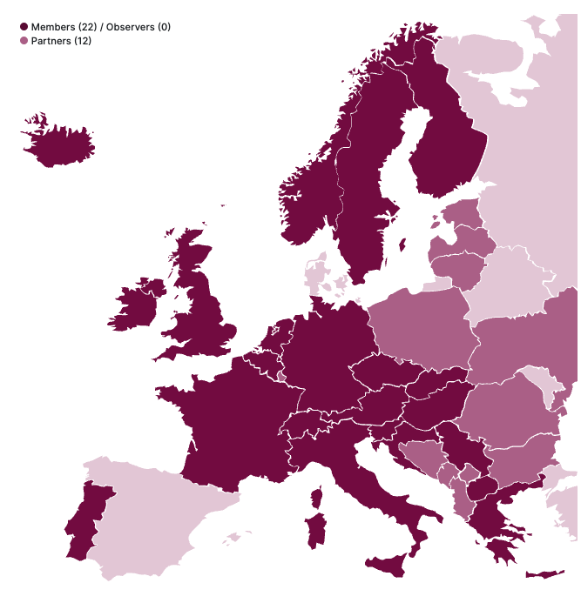
The need for a Social Science Data Repository in Spain
Start a process to become part of CESSDA ERIC
(Consortium of the European Social Science Data Archives):
Spain is not yet part of it
Potential Contributions from the Computational Social Science program @BSC:
  FAIRification of social science data
  Integration with other European (and world-wide) repositories, EOSC, and Data Spaces
CESSDA Membership

Slide 39
Thank you
merce.crosas@bsc.es

